Slide 1
Getting Started with Azure Blueprints

Slide 2
The Problem
Good practice pushes us to have several subscriptions for different purposes/products/customers, etc
Compliance requirements make us document our processes and need us to audit what we do
Manually setting permissions, etc is prone to failure

Slide 3
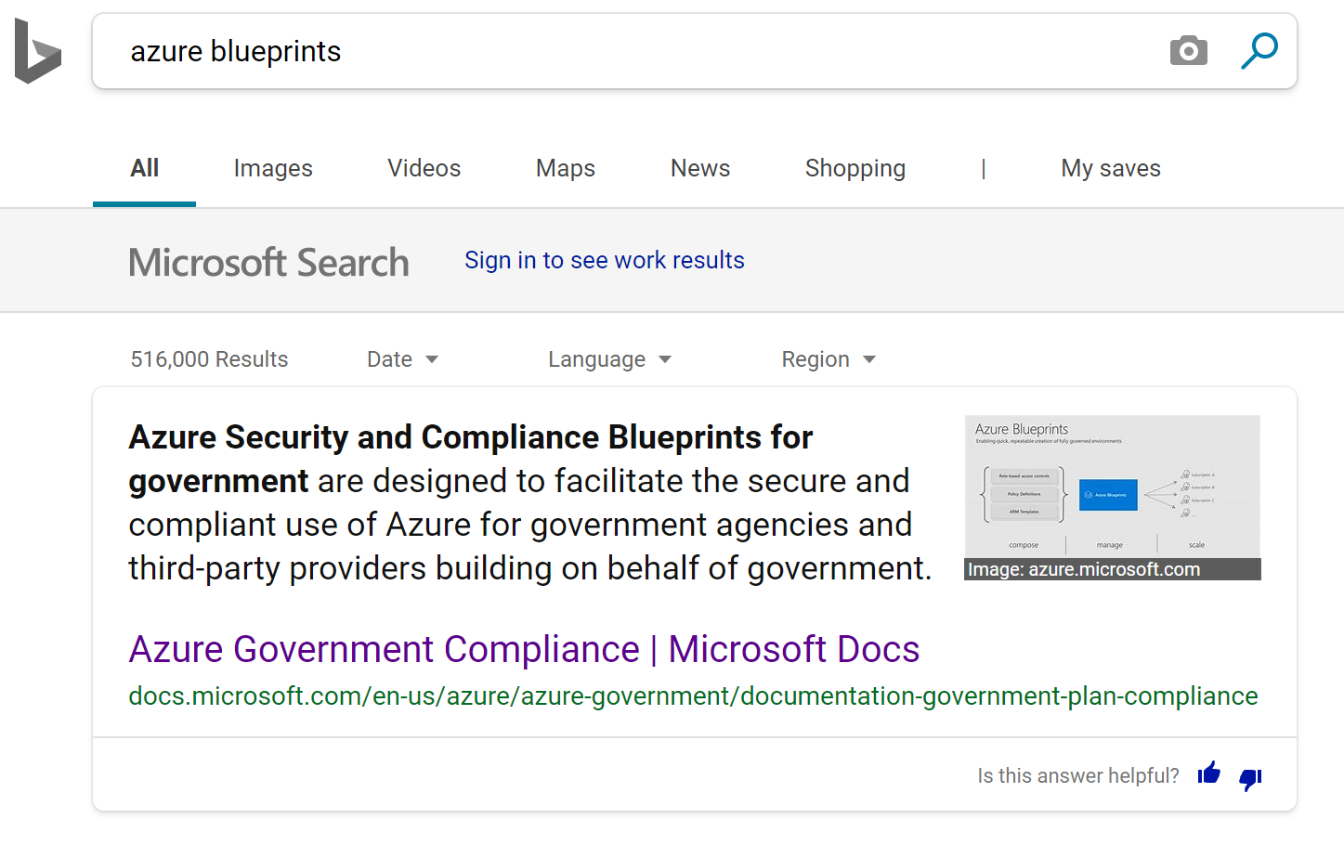

Slide 4
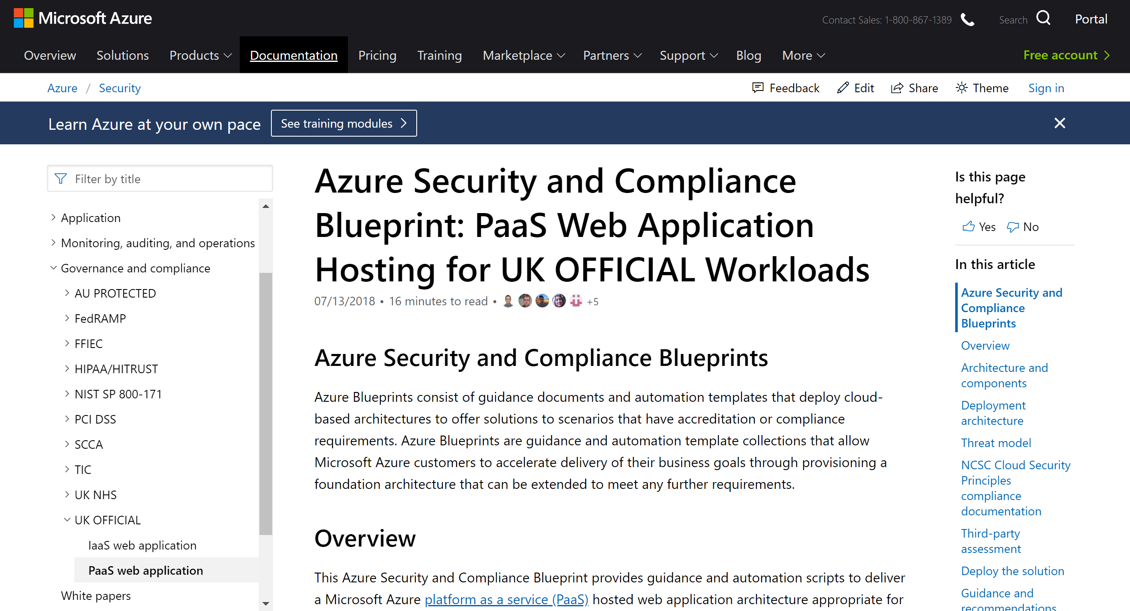
Notes:
These blueprints are in https://docs.microsoft.com/en-us/azure/security/

Slide 5
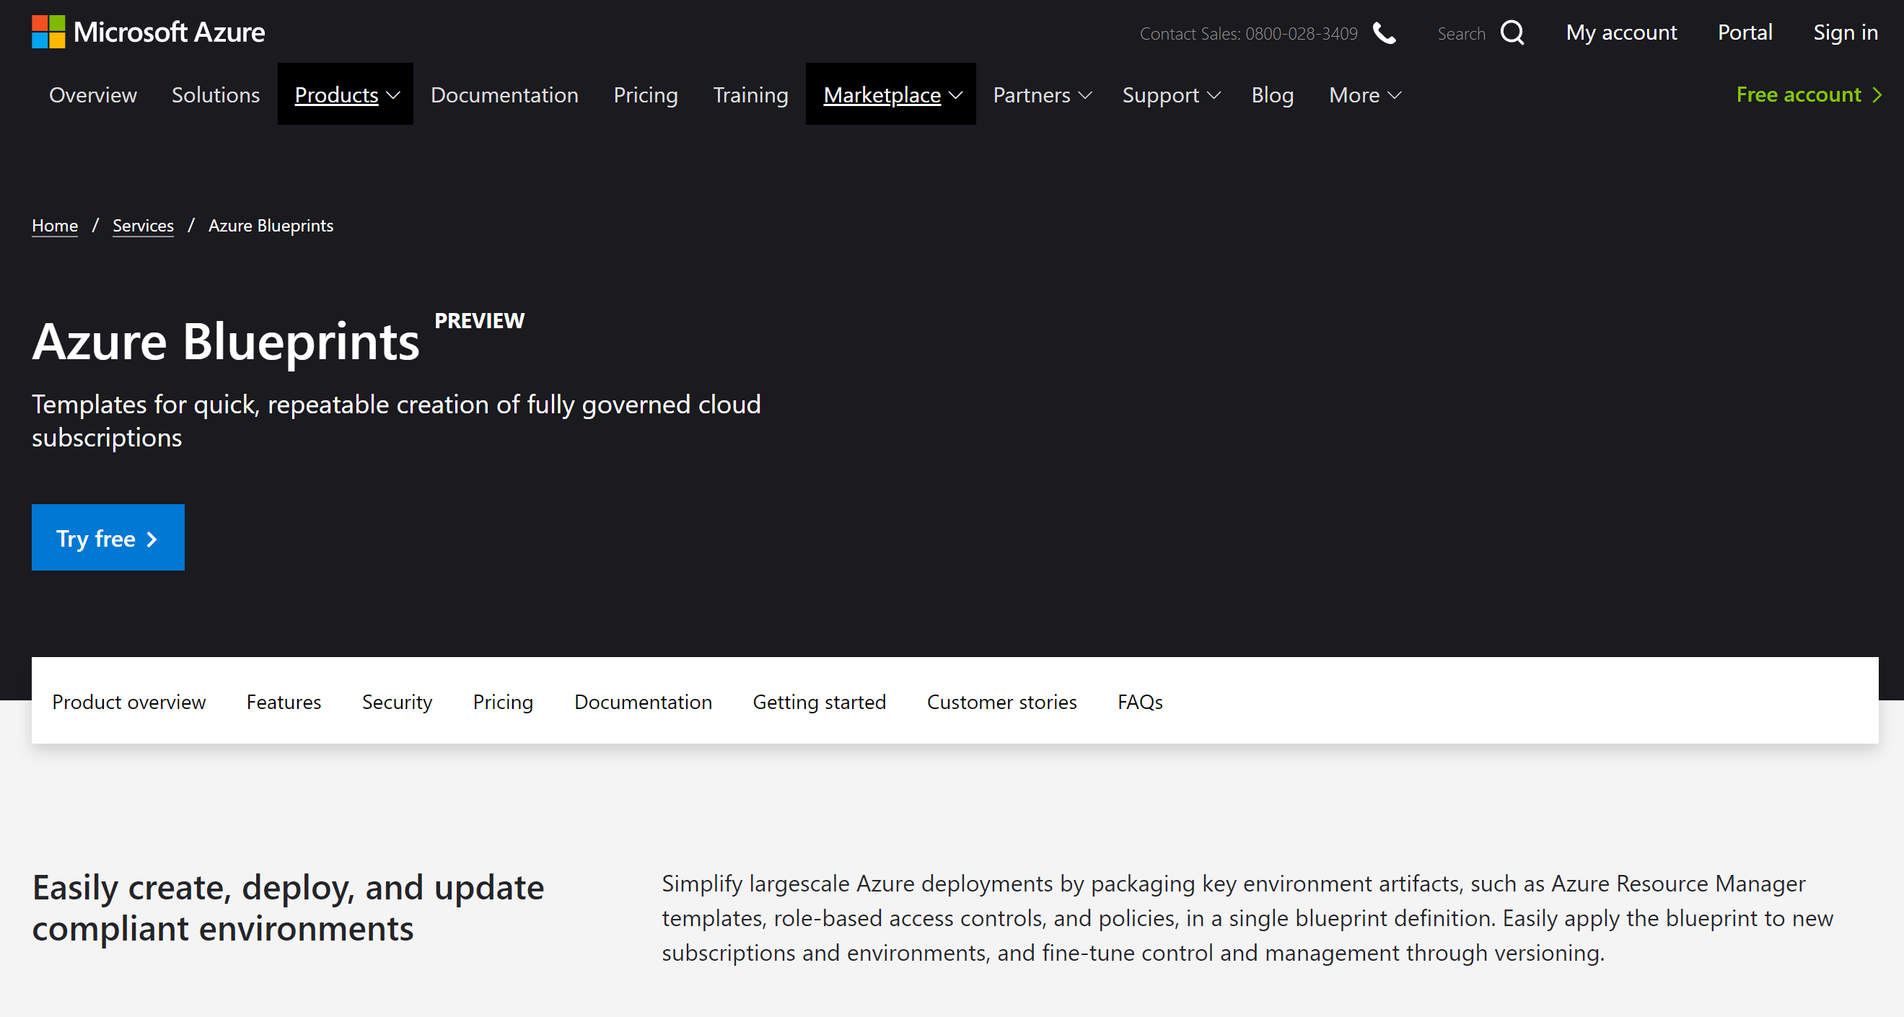
Notes:
These blueprints are in https://azure.microsoft.com/en-us/services/blueprints/ and https://docs.microsoft.com/en-us/azure/governance/blueprints/

Slide 6
What are Azure Blueprints?
Azure BluePrints are not Azure BluePrints
But, some of parts of some of the Azure BluePrints have been created to deploy through Azure BluePrints
I’m glad we cleared that up!

Slide 7
Henceforth, when I say
Azure Blueprints I mean the service

Slide 8



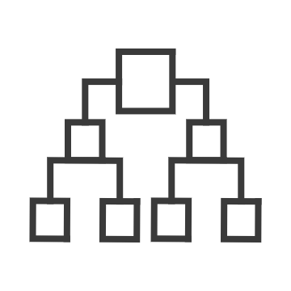
Azure Governance Components
Policy
Blueprints
Resource Graph
Management Group
Cost
Real-time enforcement, compliance assessment and remediation
Deploy and update cloud environments in a repeatable manner using composable artifacts
Query, explore & analyze cloud resources at scale
Define organizational hierarchy
Monitor cloud spend and optimize resources
Control
Environment
Visibility
Hierarchy
Consumption

Slide 9
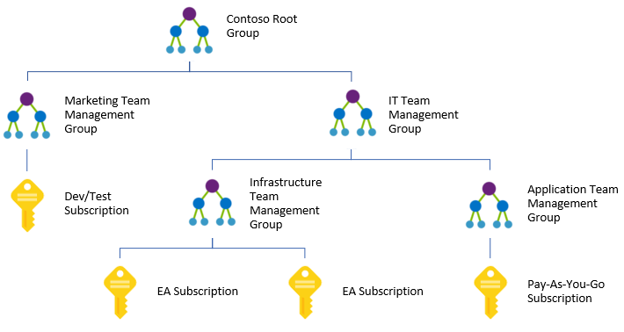
Management Groups
Hierarchy built against AAD Tenanant
Collects related subscriptions together

Slide 10
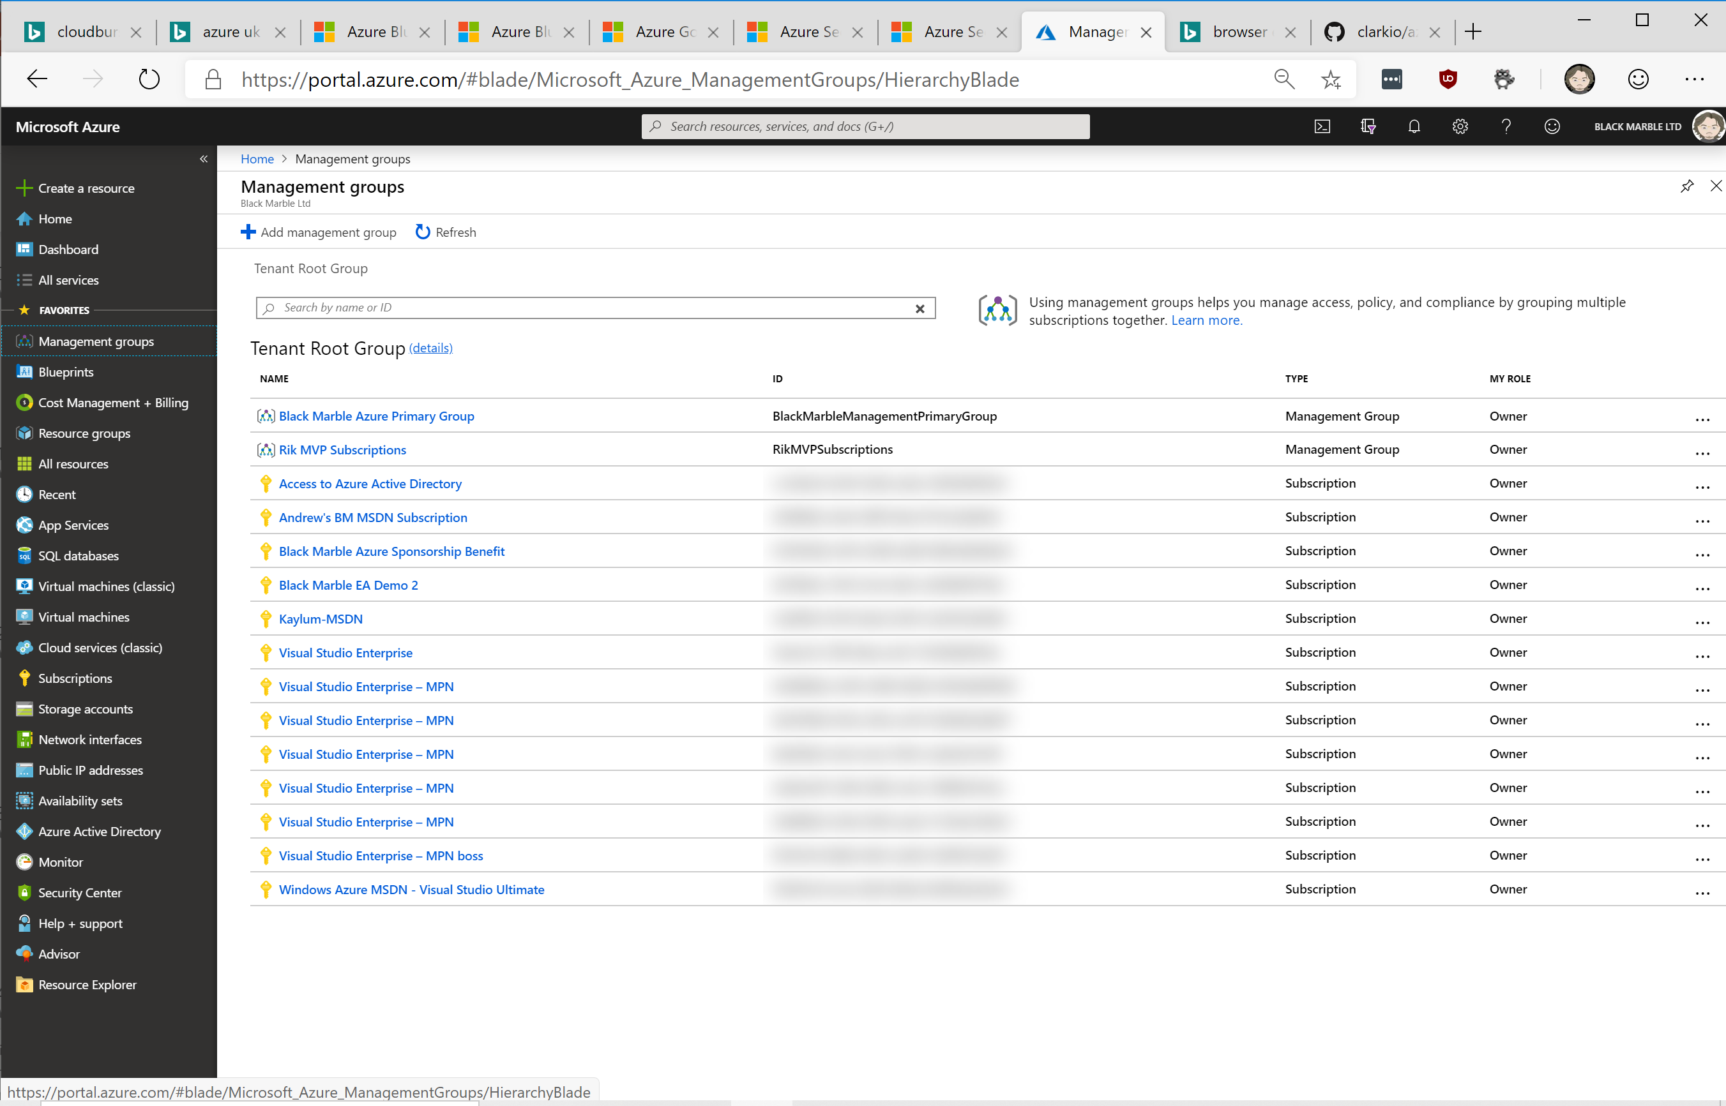
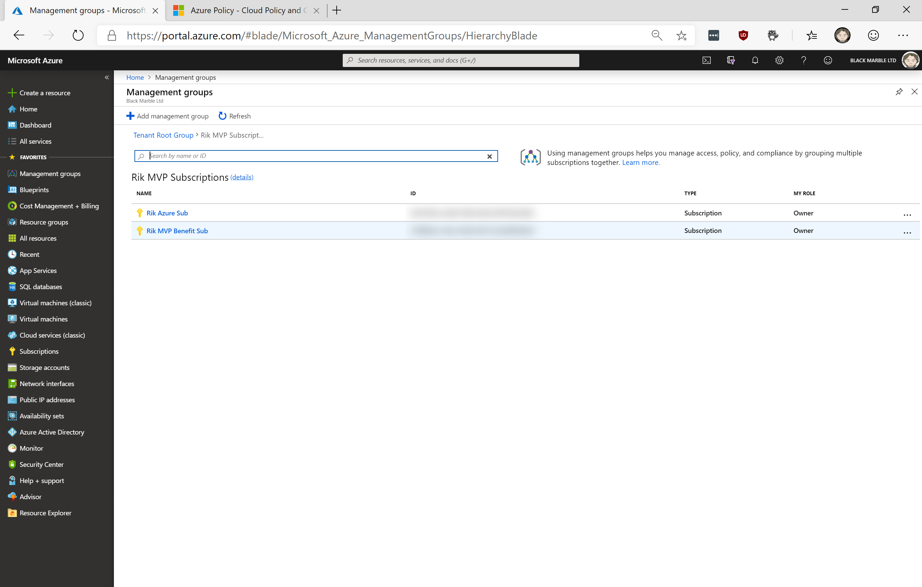
Collect subscriptions into hierarchies

Slide 11
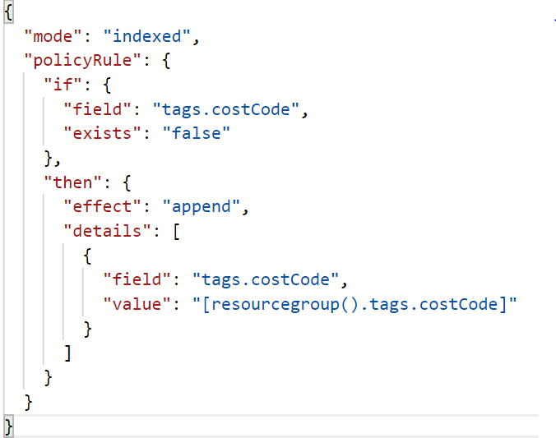
Azure Policy
Establish rules against subscriptions
Can audit or action
Great for scenarios like region and service restrictions
Can help naming conventions…

Slide 12
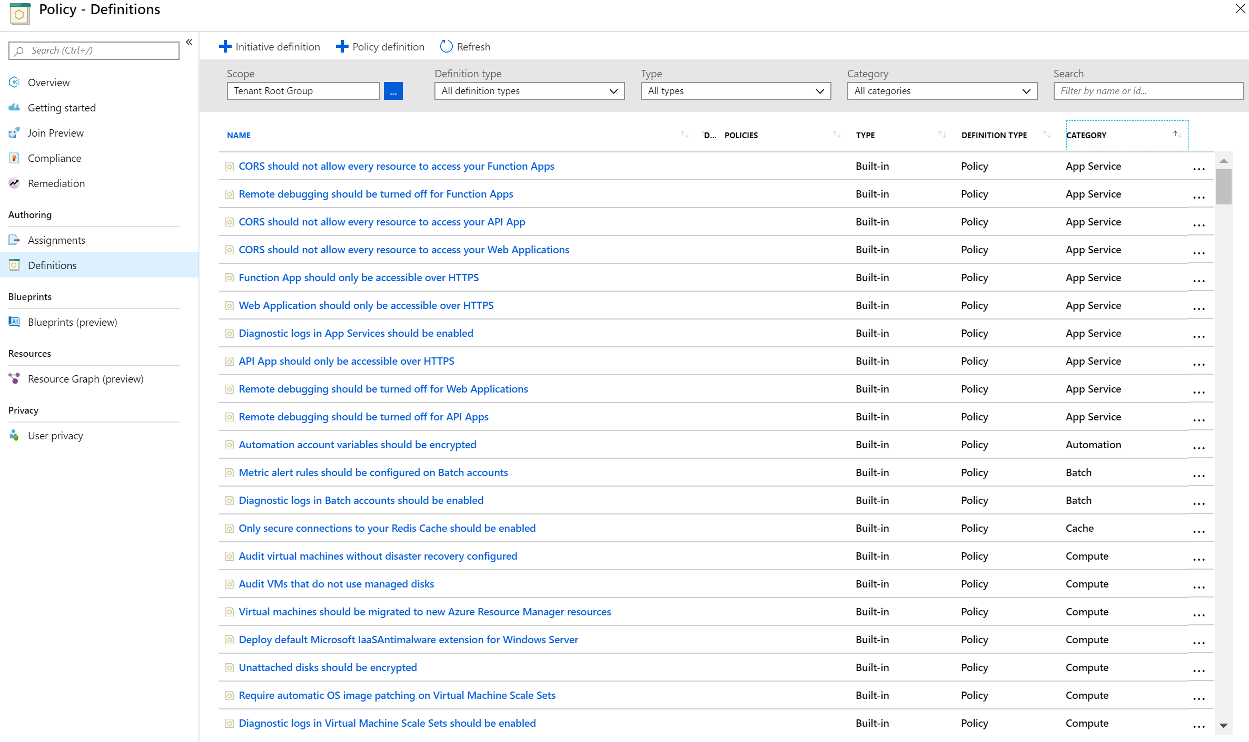

Slide 13
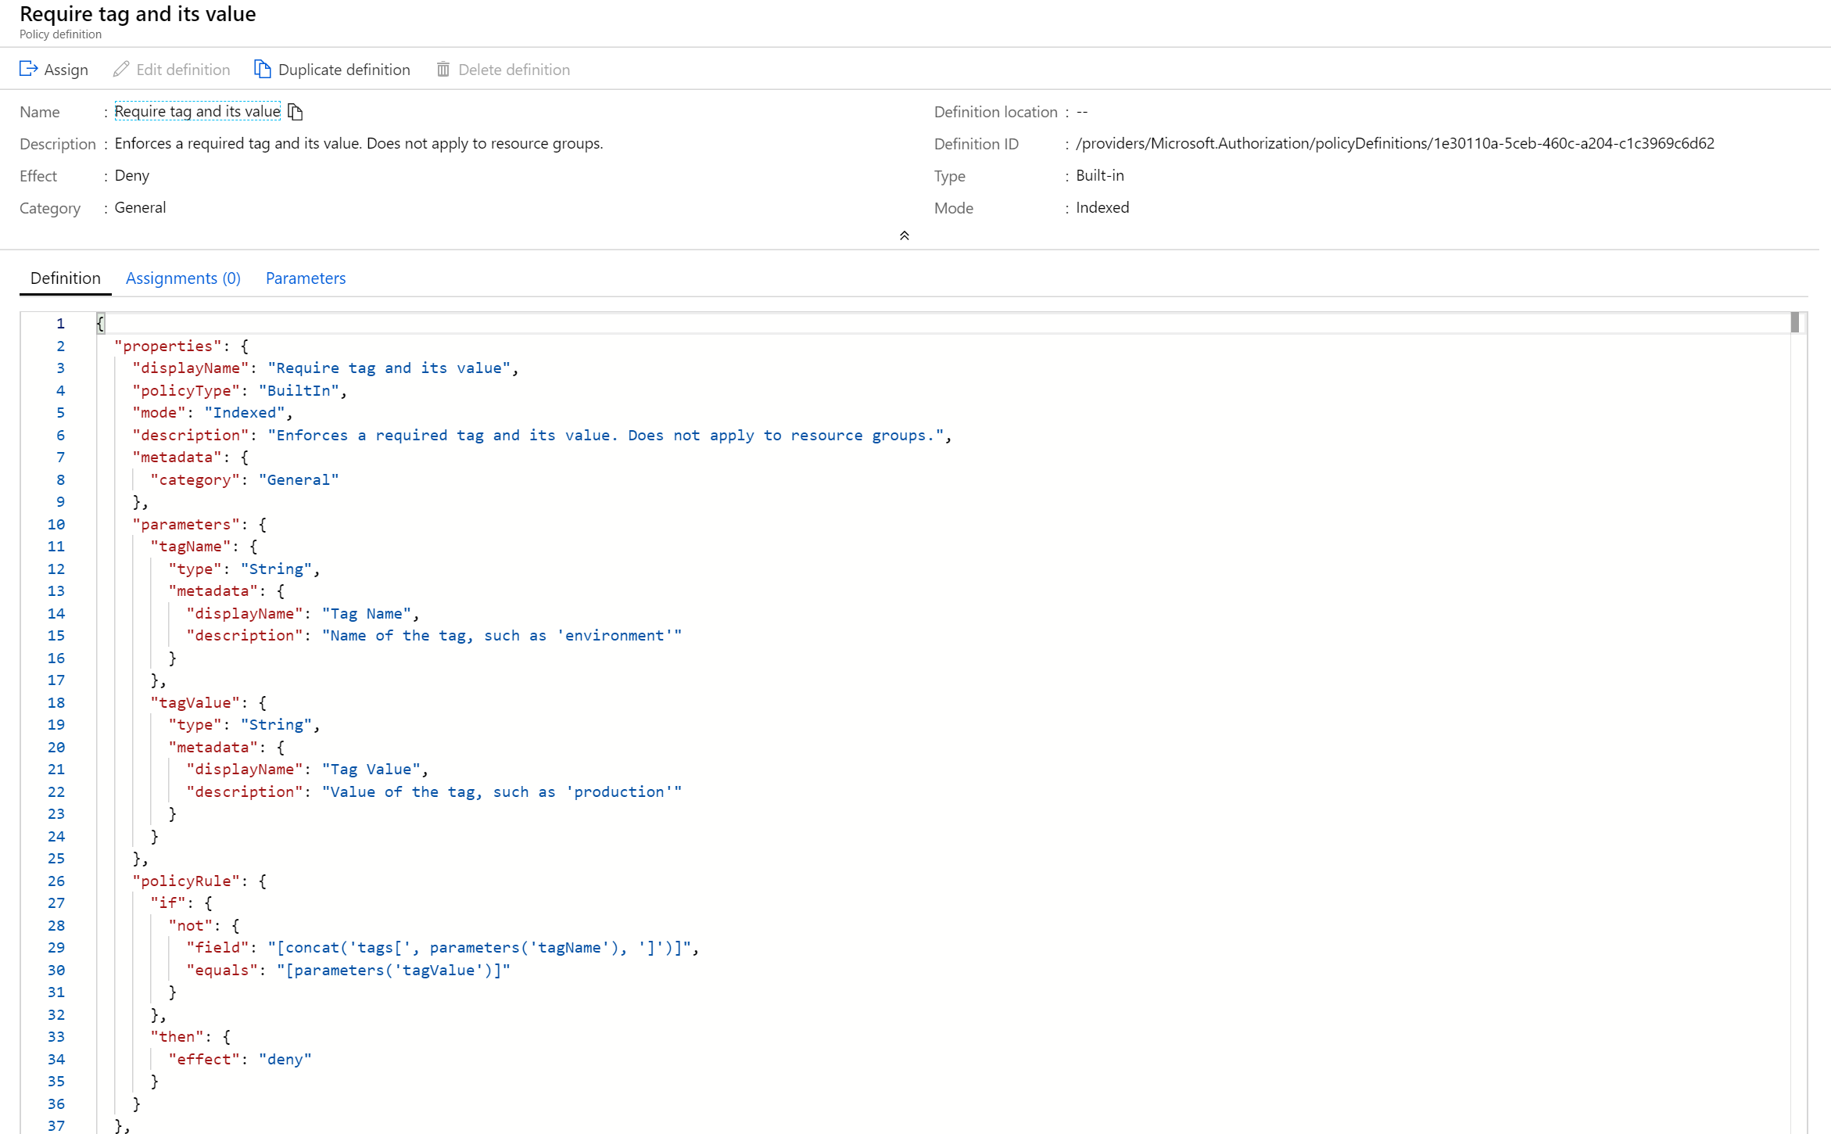

Slide 14
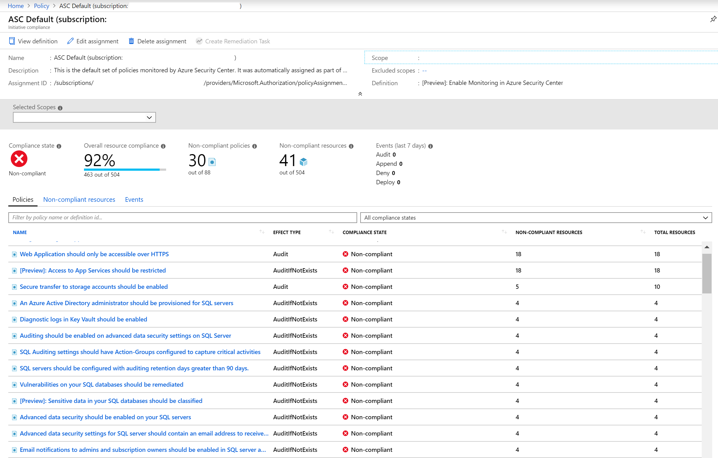

Slide 15
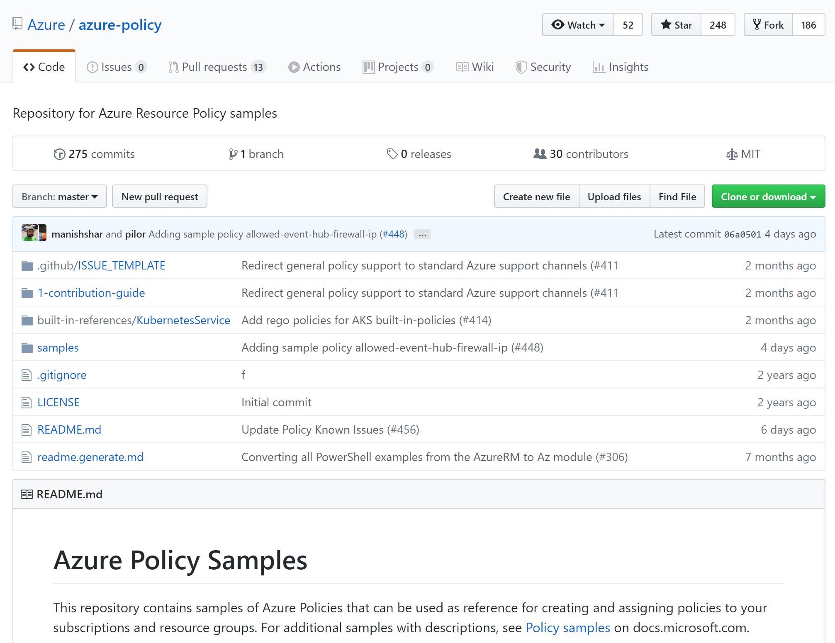
Notes:
https://github.com/Azure/azure-policy

Slide 16
Blueprints
‘Governance as code’
Single artefact collecting:
Policies
RBAC assignments
ARM artefacts
Resource Groups
Versioned
Applied to subscriptions – assignments

Slide 17

How it works
ARM Templates
Policy Definitions
Contoso Blueprint
2
Secure foundational resources
Role-based access controls
Subscription A
Cloud Engineer
Subscription B
1
Custom Scripts*
Create a Blueprint definition and add artifacts
Subscription C
3
…
Stamp out environments
Cloud Architect
ISO 27001
Coming in June
4
Version and Update Blueprints
FedRAMP
+
NIST
…
5
Built-in Blueprints

Slide 18
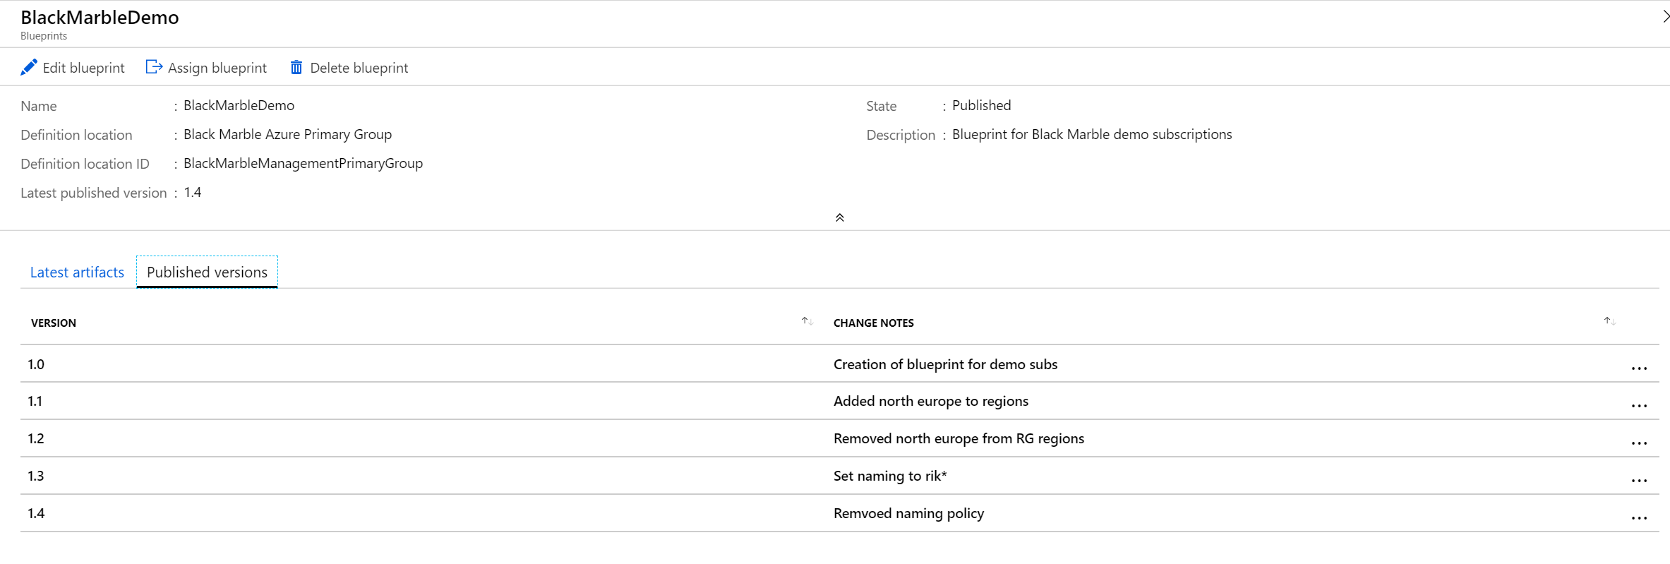

Slide 19
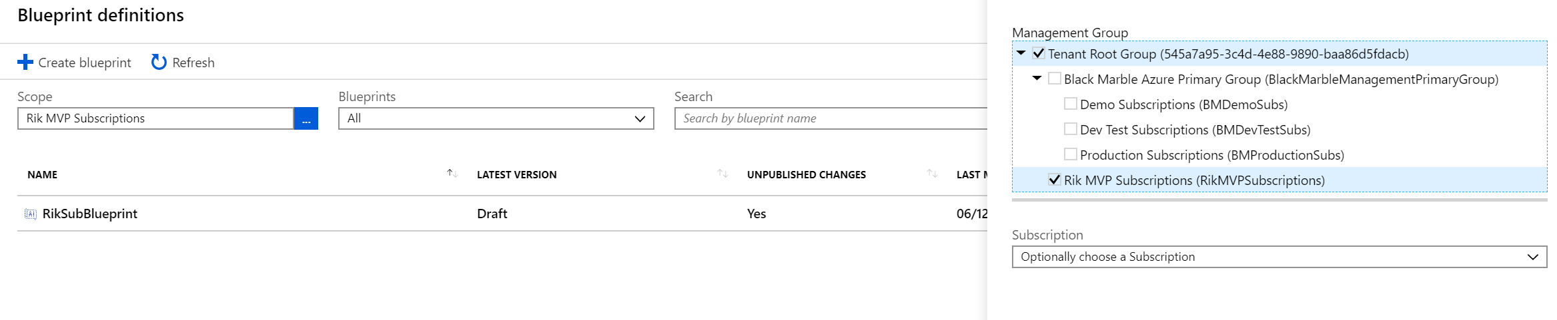
Combine Management Groups and Blueprints

Slide 20
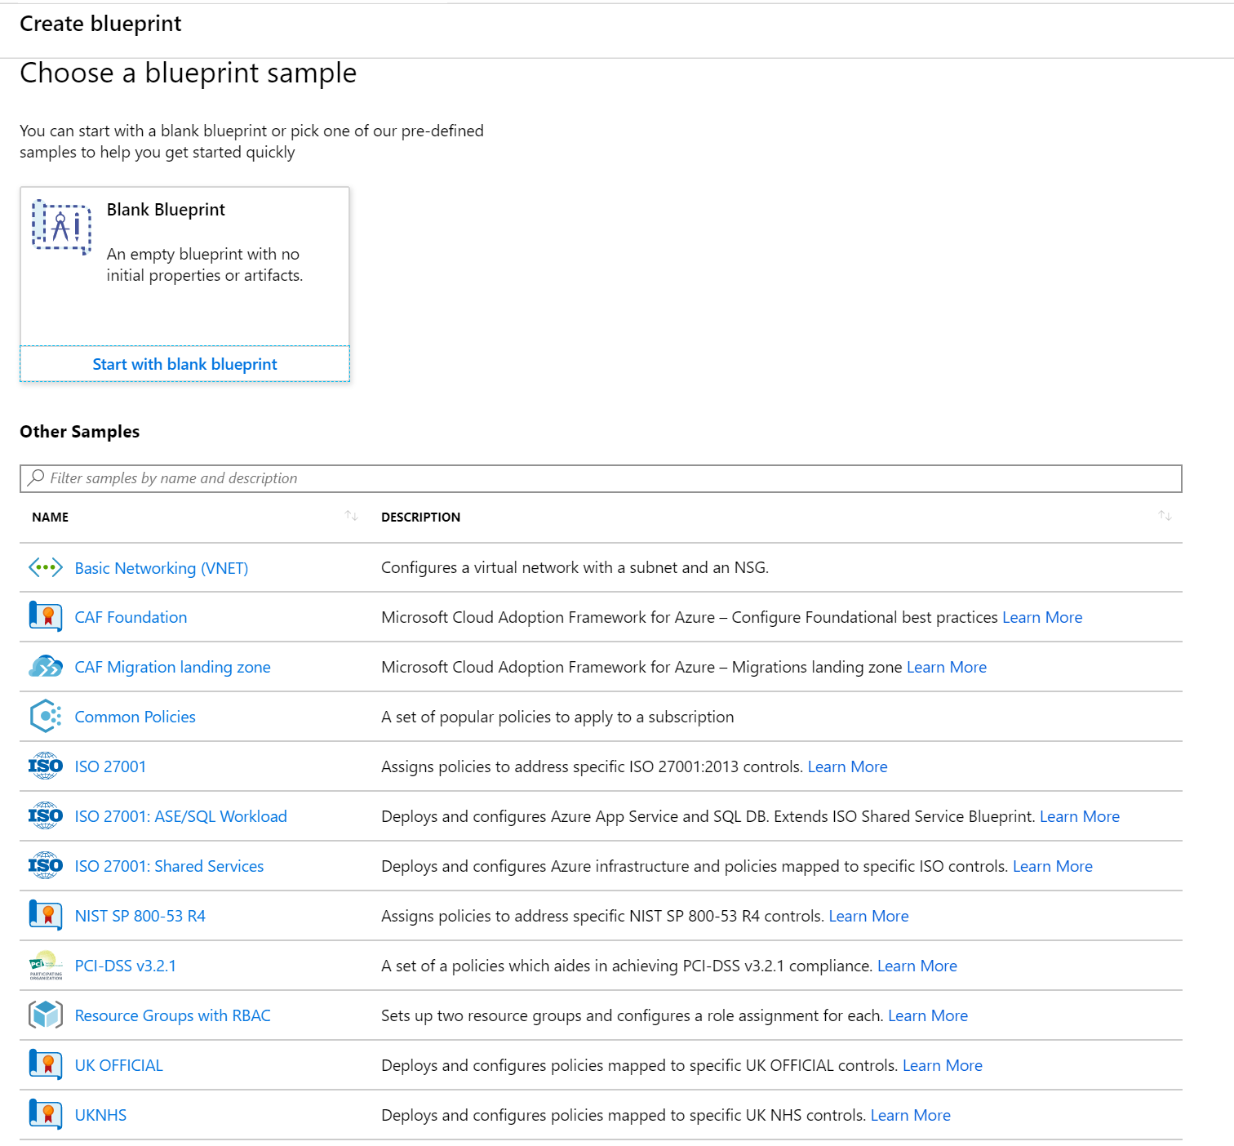
Samples
Available when creating
Include some of those ‘other’ Azure Blueprints

Slide 21
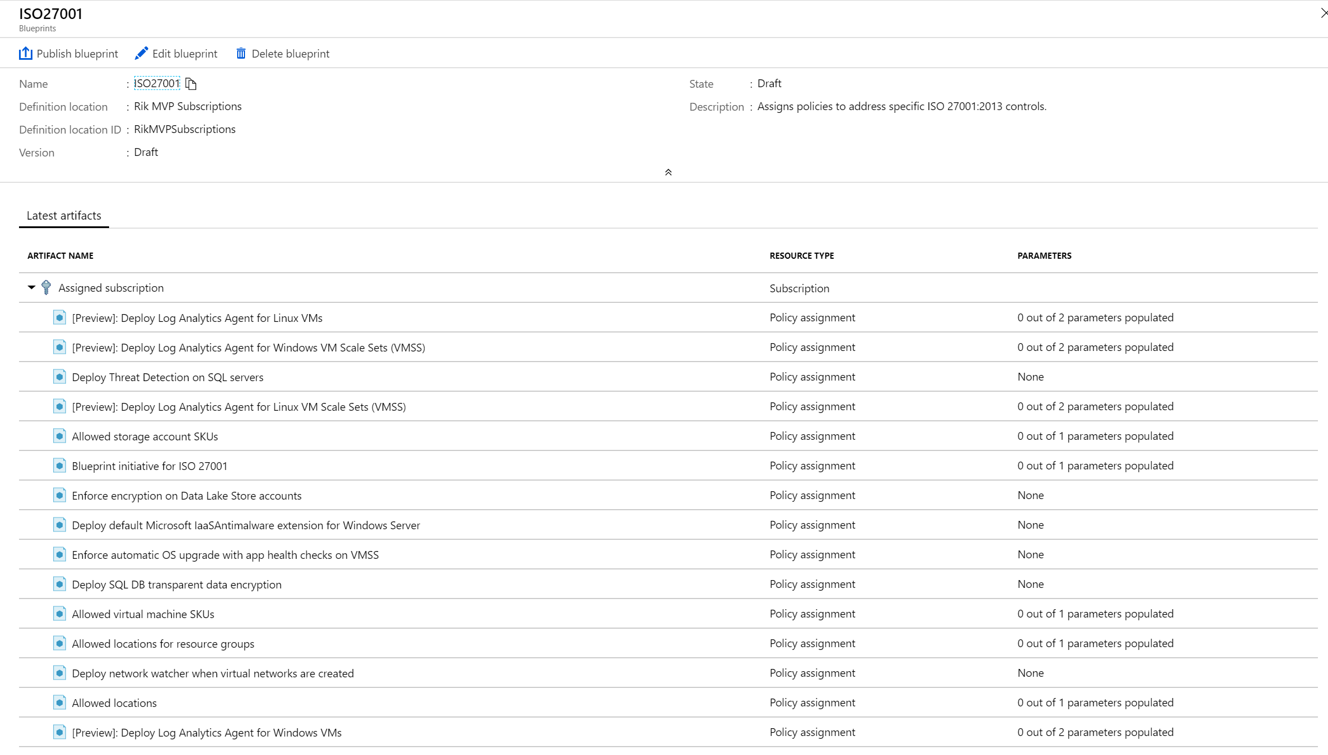

Slide 22
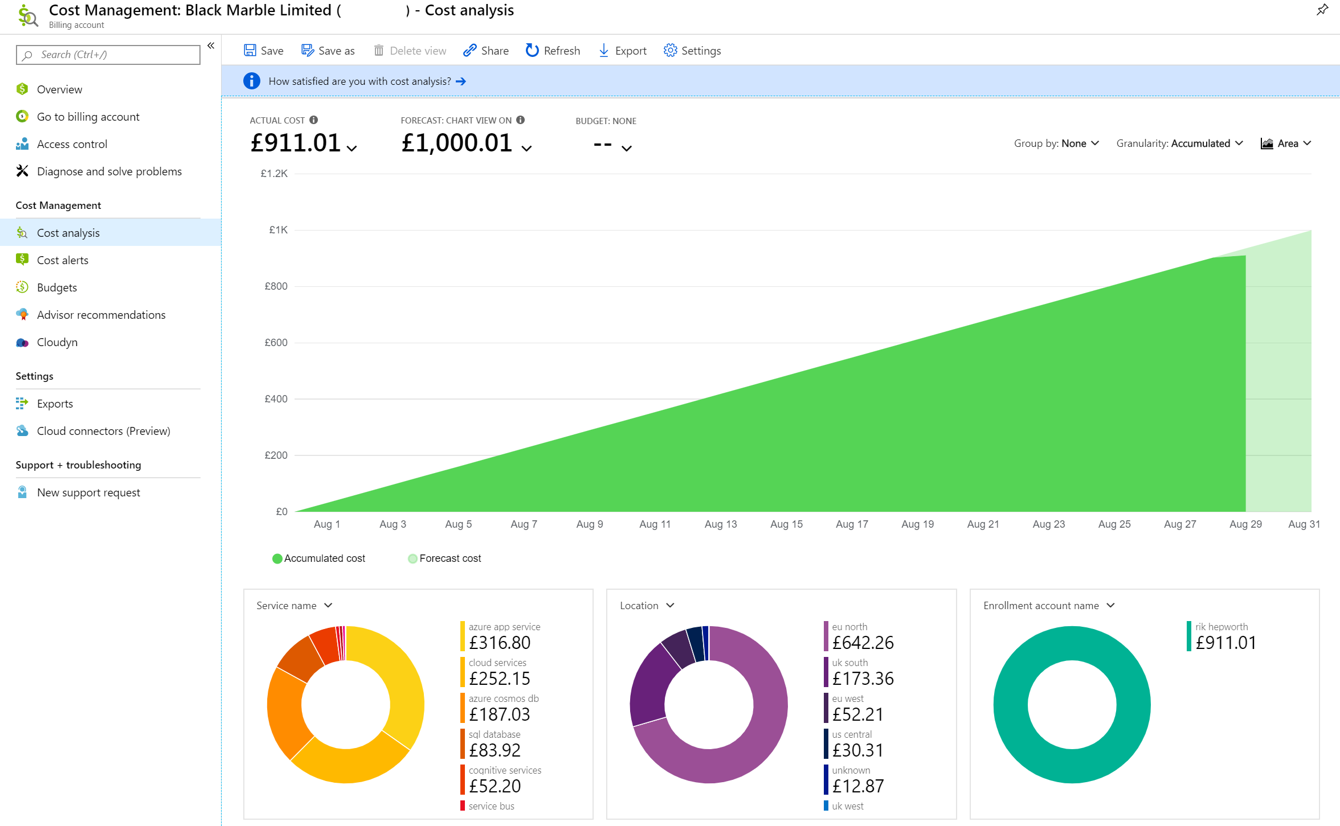

Slide 23
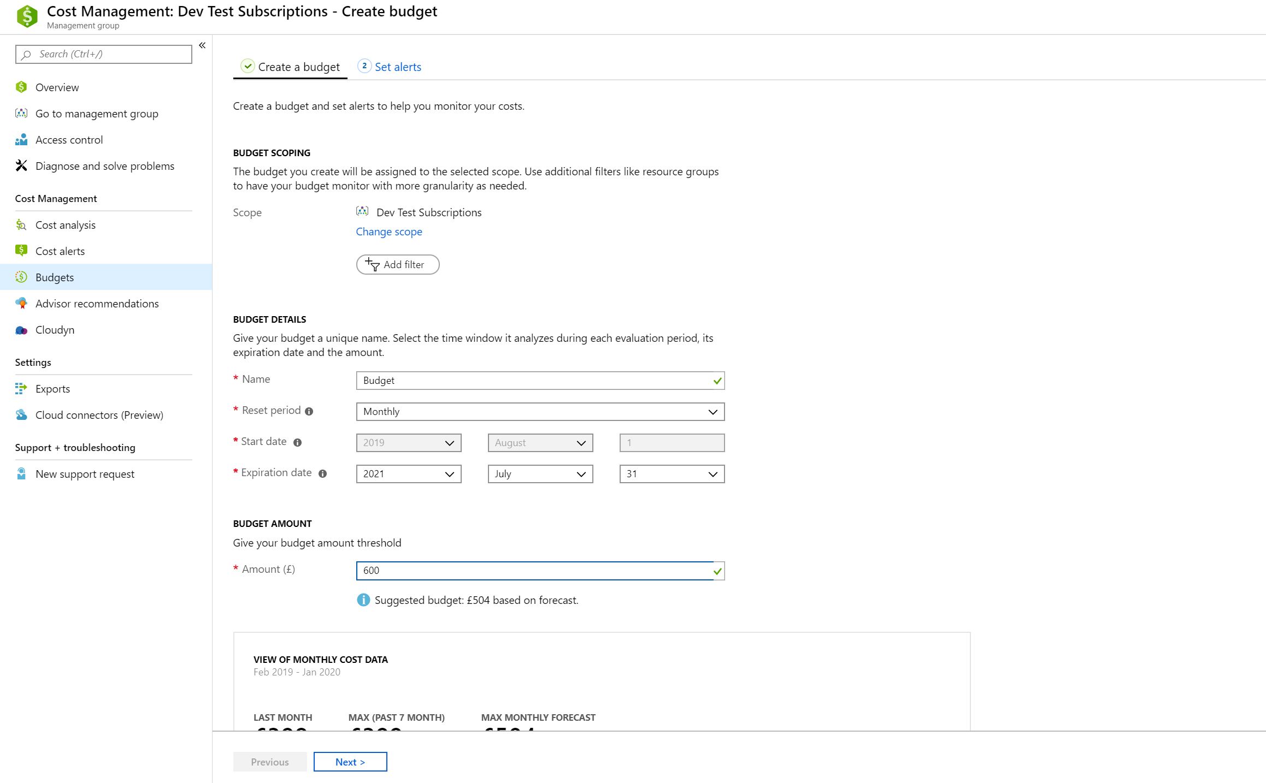

Slide 24
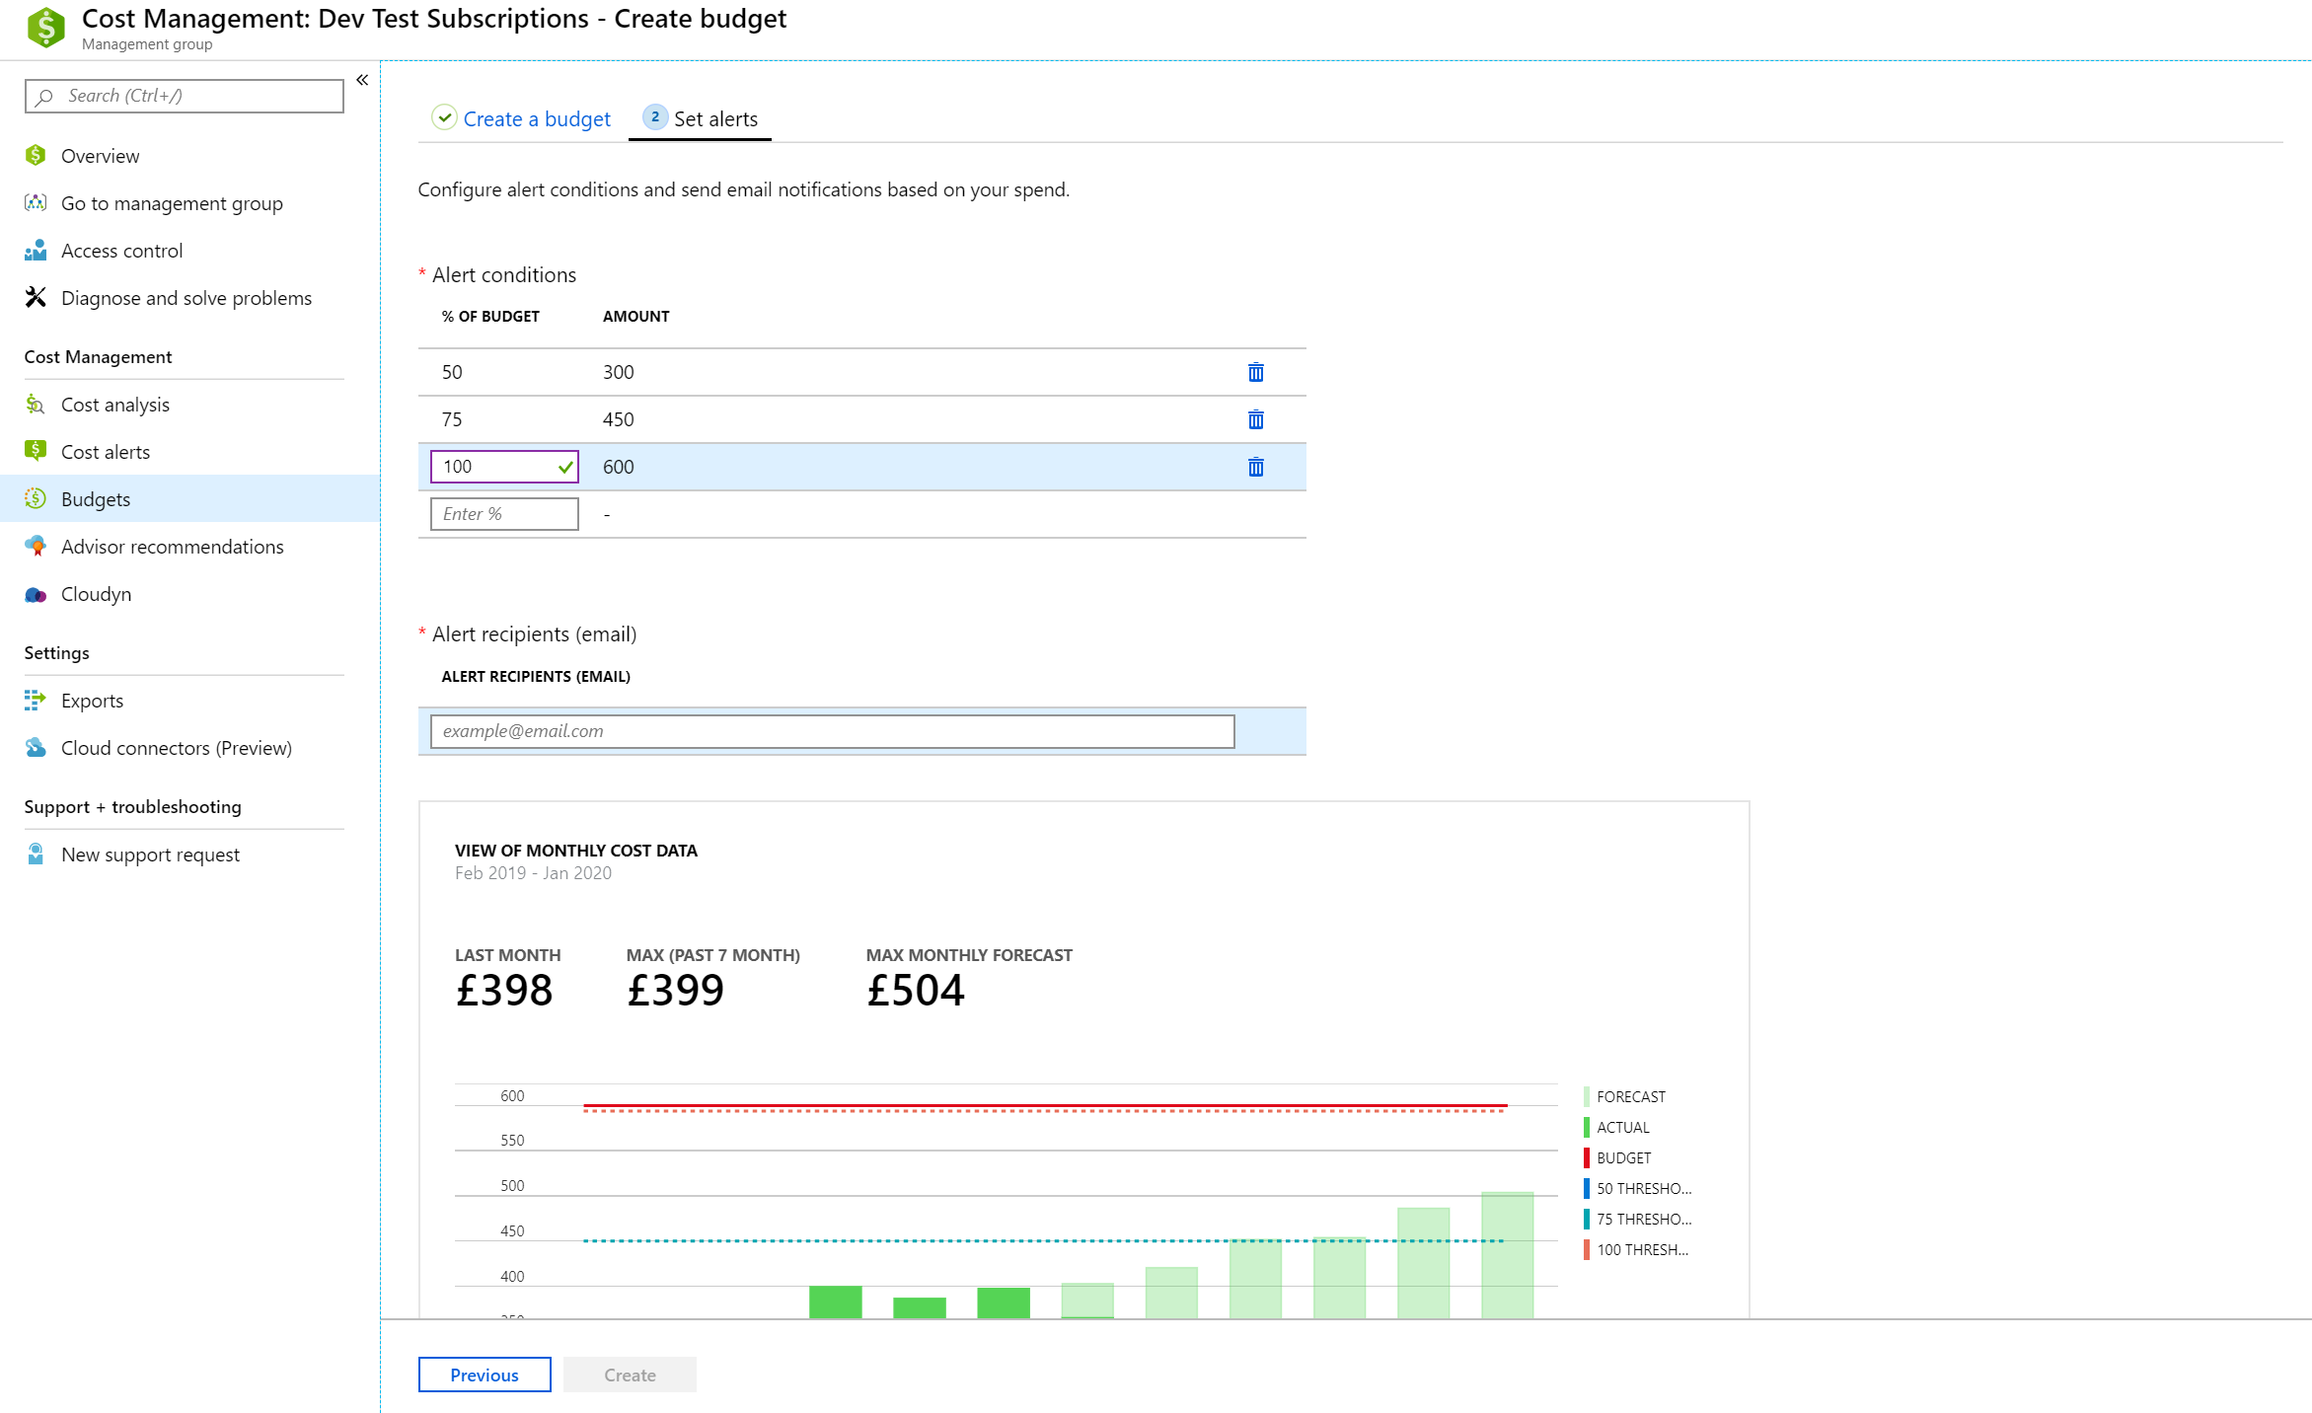

Slide 25
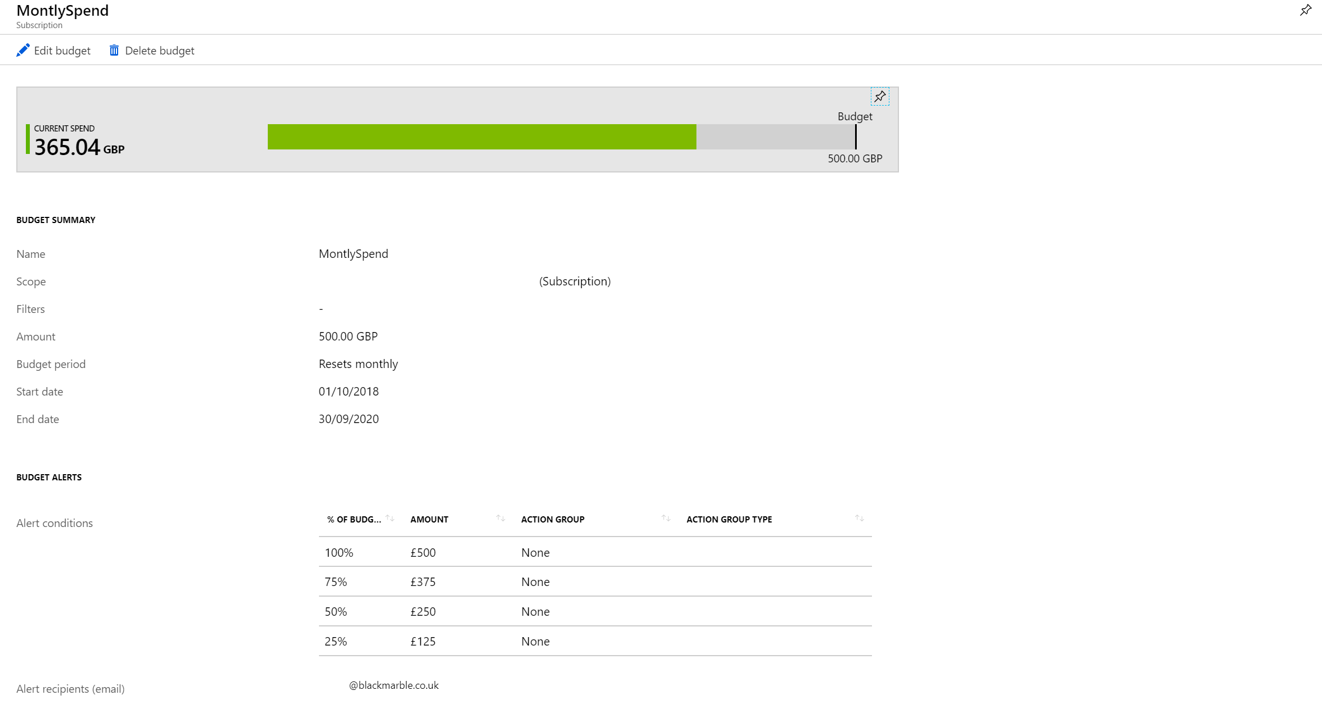

Slide 26
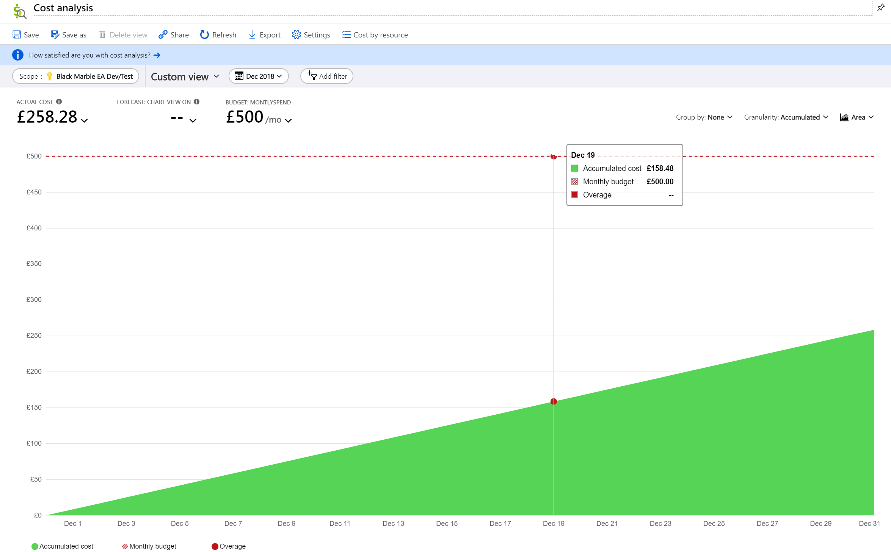

Slide 27
Demo

Slide 28
Notes:
Demo is 6’ 15’’

Slide 29
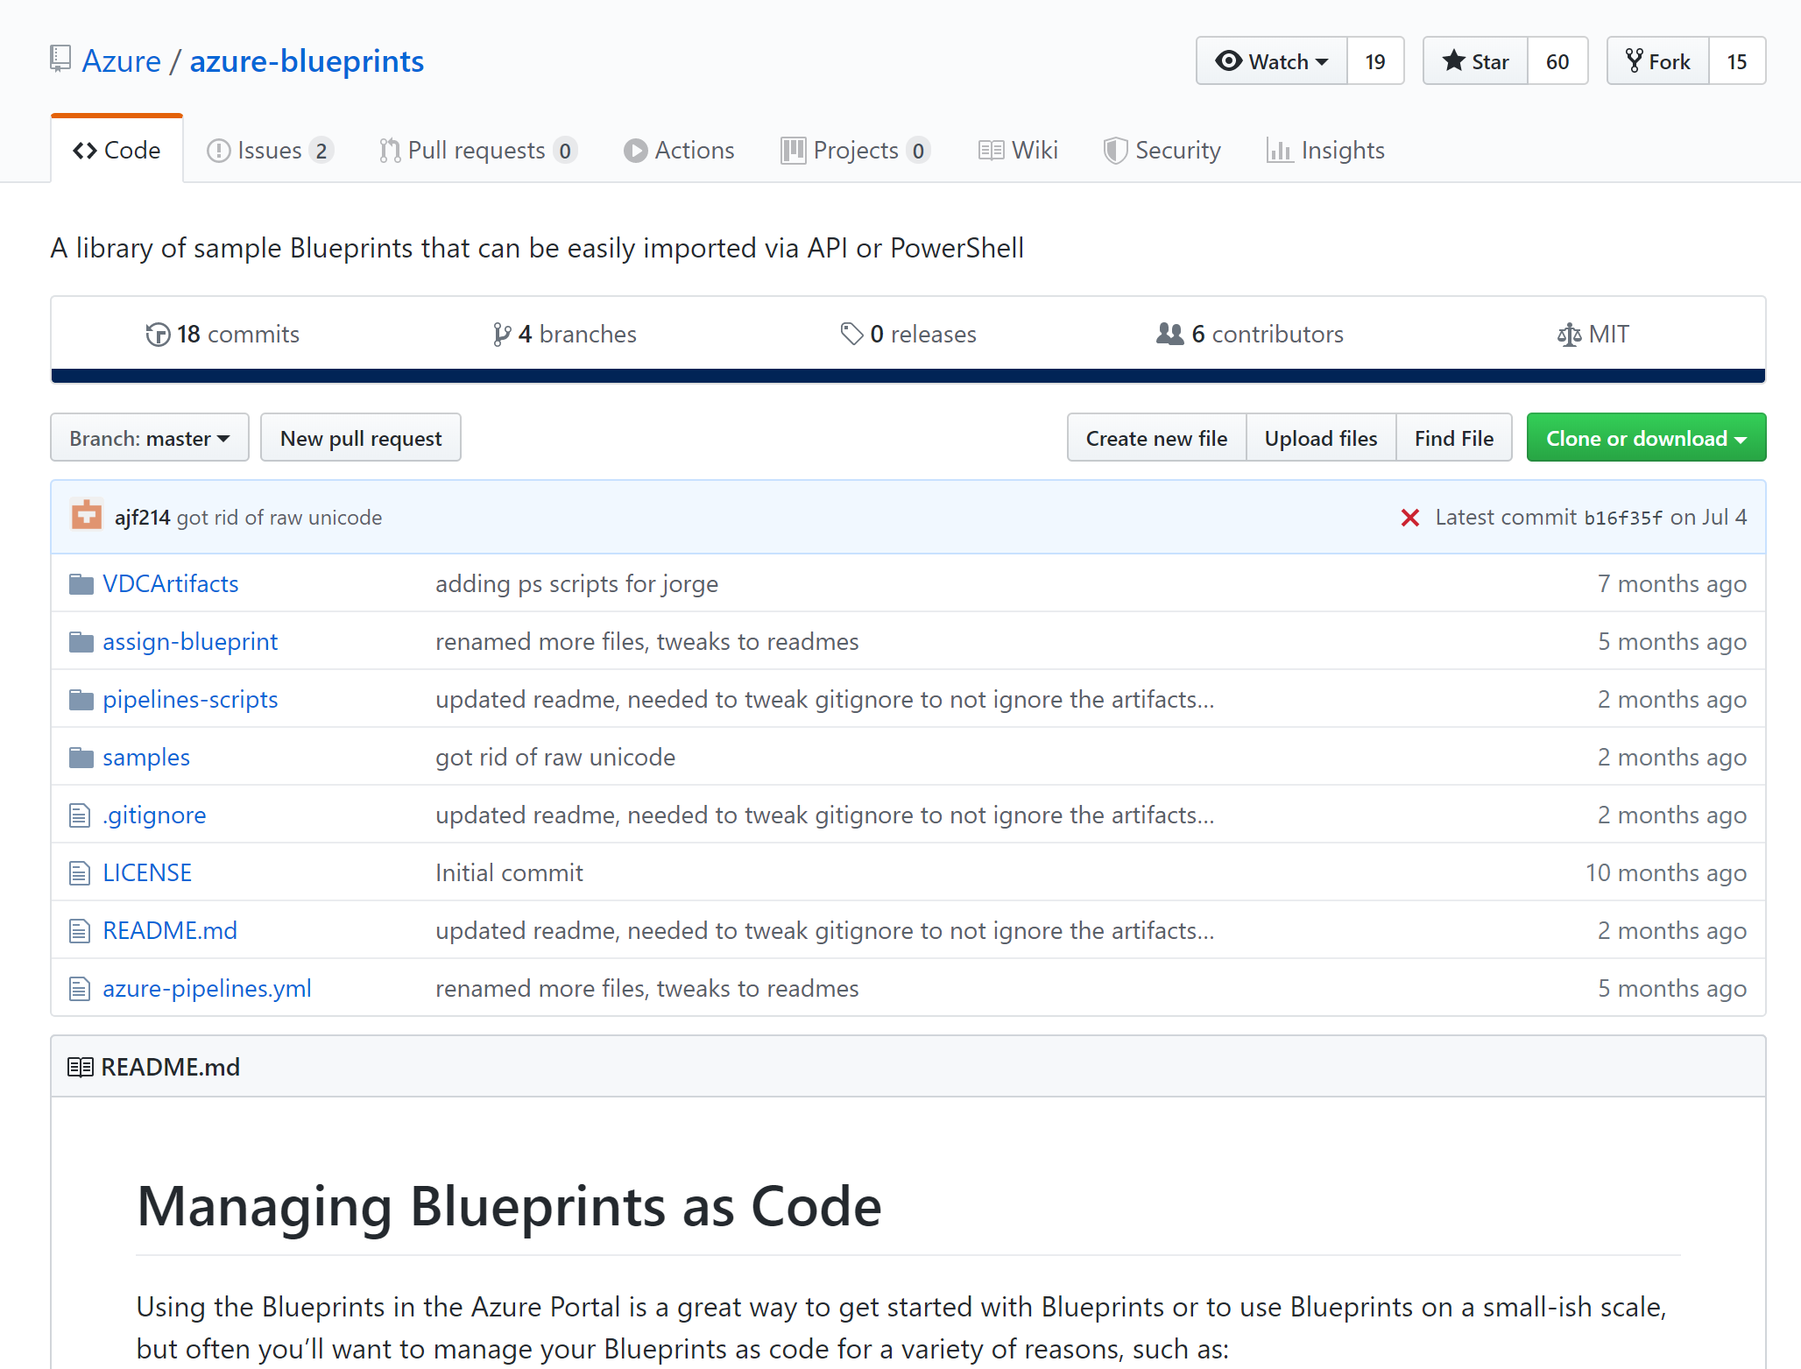
Notes:
https://github.com/Azure/azure-blueprints

Slide 30
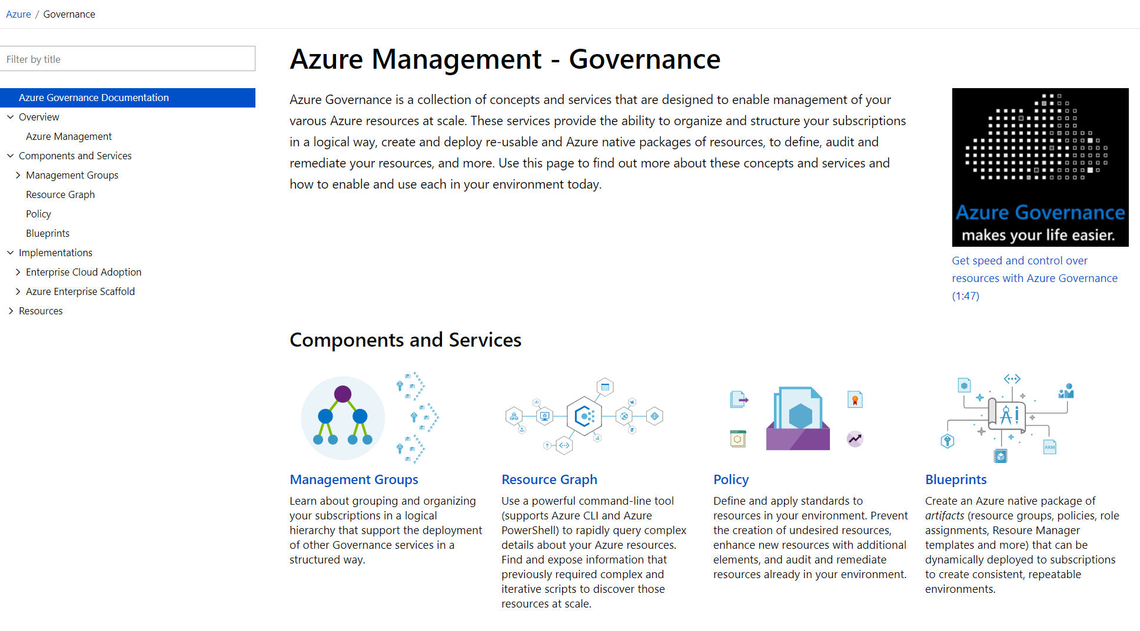
aka.ms/GovernanceDocs -or- docs.microsoft.com/azure/governance
Notes:
Case study for MS: https://www.microsoft.com/en-us/itshowcase/enabling-enterprise-governance-in-azure

